Slide 1
STORY 2
File created on: 10/31/2023 9:11:24 AM

Slide 2
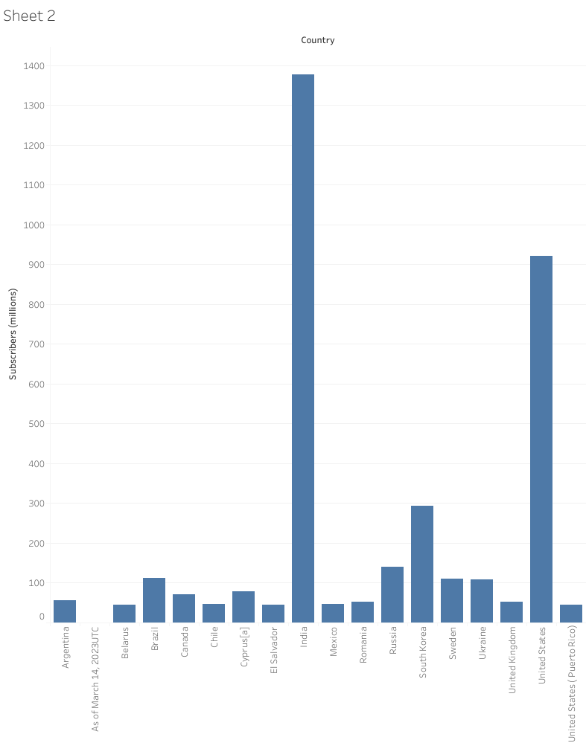

Slide 3
